Slide 1
Android Malware Detection: A Hybrid Approach using
Machine Learning Techniques
Thesis Proposal

Slide 2
Submitted By
Asadullah Hill Galib
MSSE 0718
Institute of Information Technology
University of Dhaka
Supervised By
B. M. Mainul Hossain
Associate Professor
Institute of Information Technology
University of Dhaka

Slide 3
Introduction

Slide 4

Introduction (Android Malware)
Android Malware (malicious application) is any application with mischievous intention.
It causes -
Disrupt normal functioning
bypass access controls
gather sensitive information
display unwanted advertising
getting control of device without user’s knowledge

Slide 5
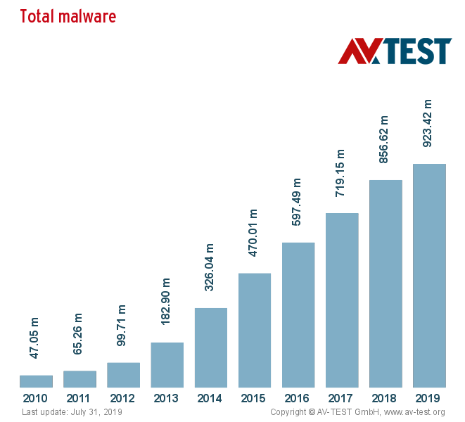
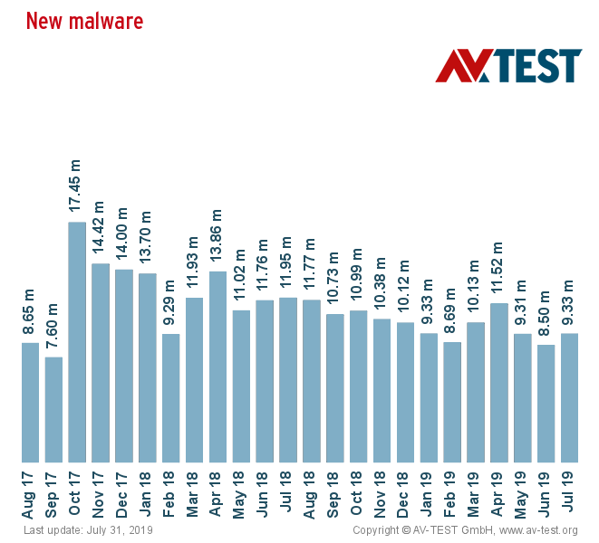
Introduction (Android Malware)

Slide 6
Introduction
Semantic Based Detection
Machine Learning Detection
(Detection Techniques)

Slide 7
Introduction
Static Analysis
Dynamic Analysis
Hybrid Analysis
(Feature Set)

Slide 8
Introduction (Static Analysis Drawbacks)
Drawbacks:
Data obfuscation
Control flow obfuscation
Dynamic XML loading
Native code
Encryption

Slide 9
Introduction (Dynamic Analysis Drawbacks)
Drawbacks:
Limited code coverage
Tricked in emulated environment by smart malware

Slide 10
Introduction (Related Works: Hybrid)
Hybrid Analysis:
7 static features + nativeCode and network traffic for dynamic features (Mobile-sandbox) [9]
Huge numbers of static and dynamic features (Marvin) [10]
6 static features from Drebin + system call for dynamic (Samadroid) [11]
Permissions (static) + system calls (Kapratwar et al.) [12]
Deep learning approach for feature extraction (Hadm) [13]
Revealing unknown characteristics of android malware [14]

Slide 11
Research Question

Slide 12
RQ-1: How can we improve the performance of Android malware detection using Hybrid Analysis techniques?

Slide 13
Research Question (sub-questions)
SQ1. What static features are significant in detecting Android malware detection system?
SQ2. What dynamic features are significant in detecting Android malware detection system?
SQ3. How do these static and dynamic features individually and jointly exhibit impact on the performance of the Android malware detection?

Slide 14
Research Methodology

Slide 15
Research
Methodology
Literature Review
Data-set Collection
Static Feature Extraction
Dynamic Feature Extraction
Feature Selection
Classification
Evaluation
Technical Report
Hybrid Analysis for Android Malware Detection

Slide 16
Rationale of the Research

Slide 17
Rationale of the Research (Academia)
This work tends to alleviate the evasion techniques of malware authors by integrating Hybrid Analysis.
This research aims to improve the performance of malware detection process.

Slide 18
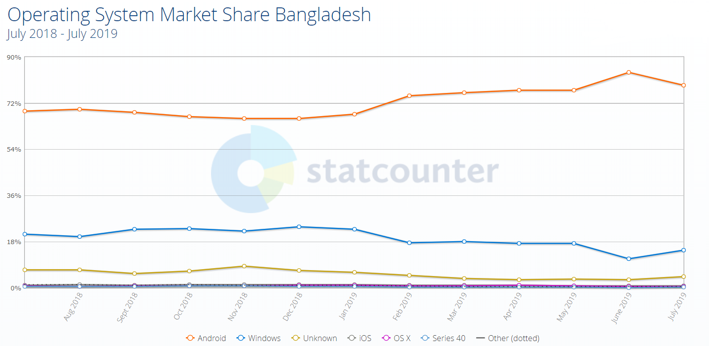
Rationale of the Research (National)

Slide 19
Rationale of the Research (National)
The new millennium development goal:
Digital Bangladesh
by 2021

Slide 20
Rationale of the Research (Government Involvement)
To enable Bangladesh to enter this multibillion dollar marketplace of android application and to develop the necessary skills to compete in this field, the IT and Communications Ministry of the Government of the People’s Republic of Bangladesh has taken many projects and performed many activities

Slide 21
Rationale of the Research (Government Activities)
Mobile Application Idea Generation Contest
AppsSensitization Boot Camp (7 Divisions)
Apps Development Training (64 districts)
Mobileapplication ready One office One app
National Mobile App Championship

Slide 22
Rationale of the Research (National)
This research aims to detect android malware in advance effectively.
By so, this research work can assist the Bangladesh government’s new millennium development goal - “Digital Bangladesh” by 2021.

Slide 23
References
Arp, D., Spreitzenbarth, M., Hubner, M., Gascon, H., Rieck, K., & Siemens, C. E. R.T. (2014, February). Drebin: Effective and explainable detection of android malware inyour pocket. In Ndss (Vol. 14, pp. 23-26)
Yerima, S. Y., Sezer, S., McWilliams, G., & Muttik, I. (2013, March). A new androidmalware detection approach using bayesian classification. In 2013 IEEE 27th interna-tional conference on advanced information networking and applications (AINA) (pp.121-128). IEEE
Mariconti, E., Onwuzurike, L., Andriotis, P., De Cristofaro, E., Ross, G., & Stringh-ini, G. (2016). Mamadroid: Detecting android malware by building markov chains ofbehavioral models. arXiv preprint arXiv:1612.04433
Ghorbanzadeh, M., Chen, Y., Ma, Z., Clancy, T. C., & McGwier, R. (2013, January).A neural network approach to category validation of android applications. In 2013 In-ternational Conference on Computing, Networking and Communications (ICNC) (pp.740-744). IEEE
Jerome, Q., Allix, K., State, R., & Engel, T. (2014, June). Using opcode-sequencesto detect malicious Android applications. In 2014 IEEE International Conference onCommunications (ICC) (pp. 914-919). IEEE
Yan, L. K., & Yin, H. (2012). DroidScope: Seamlessly Reconstructing the OS andDalvik Semantic Views for Dynamic Android Malware Analysis. In Presented as partof the 21st USENIX Security Symposium (USENIX Security 12) (pp. 569-584)
Wu, W. C., & Hung, S. H. (2014, October). DroidDolphin: a dynamic Android malwaredetection framework using big data and machine learning. In Proceedings of the 2014Conference on Research in Adaptive and Convergent Systems (pp. 247-252). ACM

Slide 24
References
8. Enck, W., Gilbert, P., Han, S., Tendulkar, V., Chun, B. G., Cox, L. P., ... & Sheth,A. N. (2014). TaintDroid: an information-flow tracking system for realtime privacymonitoring on smartphones. ACM Transactions on Computer Systems (TOCS), 32(2),5.
9. Spreitzenbarth, M., Freiling, F., Echtler, F., Schreck, T., Hoffmann, J. (2013, March).Mobile-sandbox: having a deeper look into android applications. In Proceedings of the28th Annual ACM Symposium on Applied Computing (pp. 1808-1815). ACM
10. Lindorfer, M., Neugschwandtner, M., Platzer, C. (2015, July). Marvin: Efficient andcomprehensive mobile app classification through static and dynamic analysis. In 2015IEEE 39th annual computer software and applications conference (Vol. 2, pp. 422-433).IEEE.
11. Arshad, S., Shah, M. A., Wahid, A., Mehmood, A., Song, H., Yu, H. (2018). Samadroid:a novel 3-level hybrid malware detection model for android operating system. IEEEAccess, 6, 4321-4339.
12. Kapratwar, A., Di Troia, F., Stamp, M. (2017). Static and dynamic analysis of androidmalware. In ICISSP (pp. 653-662).
13. Kabakus, A. T., Dogru, I. A. (2018). An in-depth analysis of Android malware usinghybrid techniques. Digital Investigation, 24, 25-33

Slide 25
References
14. Xu, L., Zhang, D., Jayasena, N., Cavazos, J. (2016, September). Hadm: Hybrid analysisfor detection of malware. In Proceedings of SAI Intelligent Systems Conference (pp. 702-724). Springer, Cham.
15. OperatingSystemMarketShareBangladesh.(n.d.).Retrievedfromhttp://gs.statcounter.com/os-market-share/all/bangladesh
16. Report, S. O. (2015, July 26). Govt launches 500 mobile apps for better service. Re-trieved from https://www.thedailystar.net/bytes/apps/govt-launches-500-mobile-apps-better-service-116977
17. Report, S. B. (2015, March 07). Govt to make 500 mobile apps in Bangla. Retrievedfrom https://www.thedailystar.net/govt-to-make-500-mobile-apps-in-bangla-39757
18. ACTIVITIES. (n.d.). Retrieved from https://www.nationalappsbd.com/?pageid= 690

